Slide 1

ADIDAS SALES ANALYSIS PROJECTS
OVERVIEW REPORTS
KAMORE MAUREEN

Slide 2
BUSINESS REQUIREMENT
The aim is to empower Adidas’s decision makers with data driven insights fostering strategic growth and competitiveness in dynamic sports and athletic industry.
The goal is to enhance understanding of sales dynamics and performance drivers.
Identify geographical areas with high and low sales.
Insights into product performance, aiding in inventory and marketing decisions.
Informed Pricing and margin strategies for improved profitability.
Actionable recommendation for optimizing sales and profit across various dimensions

Slide 3
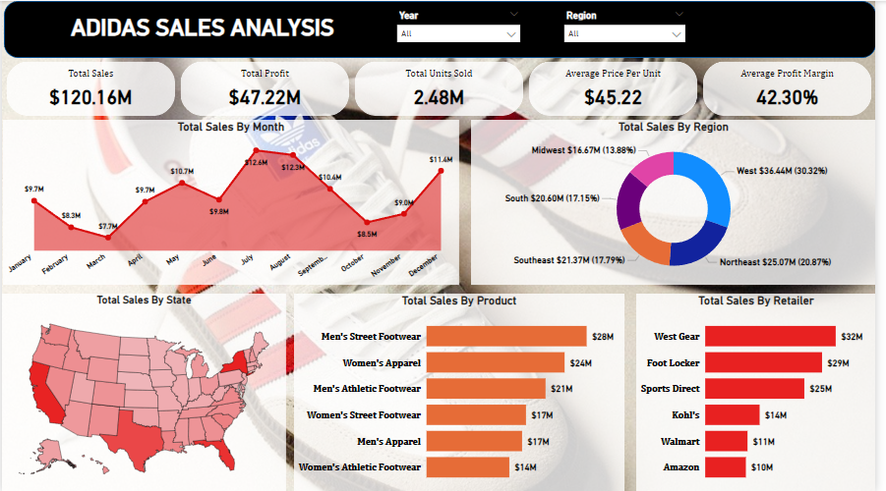

Slide 4
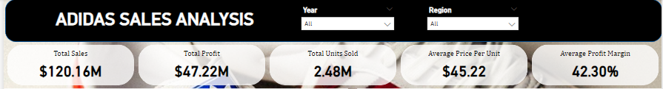
OVERVIEW KPIs
To conduct a comprehensive analysis of the Adidas Sales we need to identity the KPIs
TOTAL SALES; $120.16M
TOTAL PROFITS; $47.22M
TOTAL UNITS SOLD; 2.48M
AVERAGE PRICE PER UNIT; $45.22
AVERAGE PROFIT MARGIN; 42.30%

Slide 5
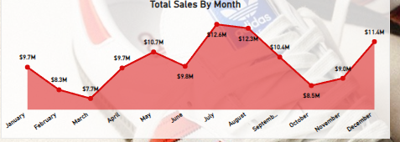
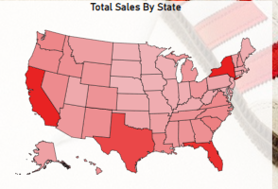
OVERVIEW
Total Sales By Month:
The Line Chart shows the total sales performance with July ($12.6M) and August ($12.3M) being the peak months.
We also get to see the sales peak up in December ($11.4M) after a huge drop in the other months. This could be because it is a holiday season.
Total Sales By State:
A heat map of the United States indicates high sales concentration in regions colored in darker shades.
New York and California taking the lead with($8.7M & $8.6M) respectively.

Slide 6
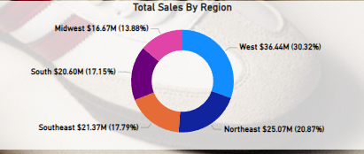
OVERVIEW
Total Sales by Region:
West: $36.64M (30.32%) (highlighted as the leading region)
Northeast: $25.07M (20.87%)
Southeast: $21.37M (17.79%)
South: $20.60M (17.15%)
Midwest: $16.67M (13.88%)

Slide 7
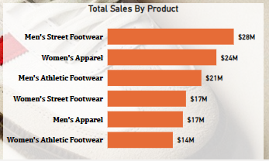
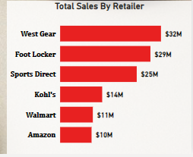
OVERVIEW
Total Sales by Product:
Men's Street Footwear: $28M
Women's Apparel: $24M
Men's Athletic Footwear: $21M
Women's Street Footwear: $17M
Men's Apparel: $17M
Women's Athletic Footwear: $14M
Total Sales by Retailer:
West Gear: $32M
Foot Locker: $29M
Sports Direct: $25M
Kohl's: $14M
Walmart: $11M
Amazon: $10M

Slide 8
KEY INSIGHTS
Top-Performing Region
West Region is the top-performing region, contributing 30.32% of total sales, amounting to $36.64M. This indicates a strong market presence in the western United States, and efforts in marketing or distribution here are yielding excellent results.
Sales Seasonality
There is a clear seasonal trend in sales, with July ($12.4M) and August ($12.3M) being the top-performing months. This could be due to potential promotions or new product releases in July and August. During the December holiday sales do up to ($11.4M). On the contrary, the beginning of the year (January-March) shows lower sales, implying possible slow seasons.
3. High Sales Concentration in Specific Product Categories
Men’s Street Footwear ($28M) is the best-selling product, followed by Women’s Apparel ($24M) and Men’s Athletic Footwear (21M). Footwear, in general, dominates sales, indicating its importance in Adidas' product lineup.
This suggests that Adidas' core market is heavily reliant on footwear products, and further innovation or marketing in this category could continue driving growth.
4. Retailer Performance
West Gear Retailer leads sales among retailers, generating ($32M), followed by Foot Locker ($29M) and Sports Direct ($25M). Adidas seems to have strong partnerships with these retailers, and they are responsible for a significant share of sales.
There is a sharp drop-off in sales for Walmart and Amazon, with $11M and $10M respectively, which suggests that traditional brick-and-mortar or sports-specific retailers are more successful sales channels compared to online or general retail platforms.

Slide 9
KEY INSIGHTS
5. Profitability
The Average Profit Margin is 42.30%, which is relatively high for the retail sector. This indicates that Adidas is maintaining healthy profit margins across its product lines, which could be attributed to premium pricing or efficient cost control.
However, analyzing margin trends across different product lines or regions could reveal further opportunities for optimization.
6. Geographic Sales Distribution
West and Northeast regions combined account for over 50% of total sales (West: 30.32%, Northeast: 20.87%). These regions should remain a priority for marketing and distribution strategies, while the Midwest ($16.67M, 13.88%) could potentially offer untapped growth opportunities if further efforts are directed towards improving sales in that region.
7. Sales by Product Type Reflects Strong Gendered Demand
Men’s footwear (both street and athletic) significantly outsells women’s footwear ($28M + $21M vs. $17M + $14M). This suggests that Adidas may have a stronger customer base among men, particularly in the footwear category. Expanding women's street footwear and Athletic footwear lines could provide opportunities for growth.

Slide 10
RECOMMENDATIONS
Expand in the West and Northeast Regions: Given the high sales in these regions, increasing advertising and product availability here could sustain the growth.
Capitalize on Seasonality: To maximize on seasonal trends, Adidas could launch targeted promotions or new product lines around July and August as well as the holiday season in December. While also devising strategies to mitigate the slow periods (e.g., January–March).
Focus on Brick-and-Mortar Retailers: West Gear, Foot Locker, and Sports Direct are strong sales channels. Strengthening partnerships with these retailers, possibly through exclusive product lines or collaborations, could further boost sales. However, Adidas might also explore ways to improve its online presence, especially with Amazon.
Product Focus: While footwear dominates, women's categories, especially in footwear, have room for growth. Marketing campaigns targeting women and expanding the product variety for Women's Footwear could close the gap.

